Slide 1
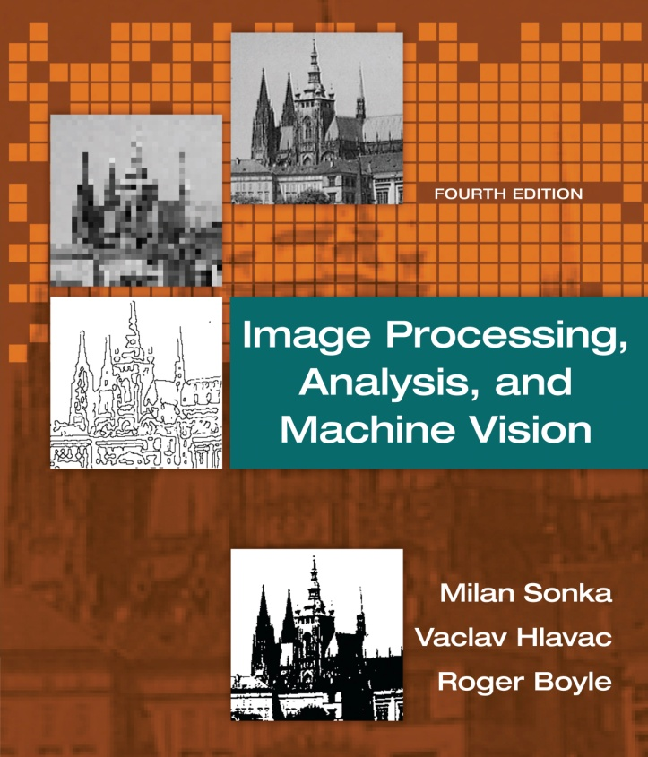

Chapter 1
Image Processing, Analysis, and Machine Vision, 4th Edition Sonka, Hlavac & Boyle
Introduction

Slide 2
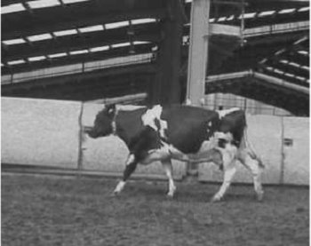
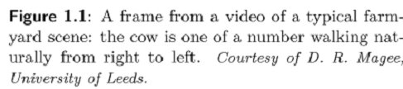
Motivation
Image Processing, Analysis, and Machine Vision, 4th Edition Sonka, Hlavac & Boyle
Video
Frame v.s. image

Slide 3
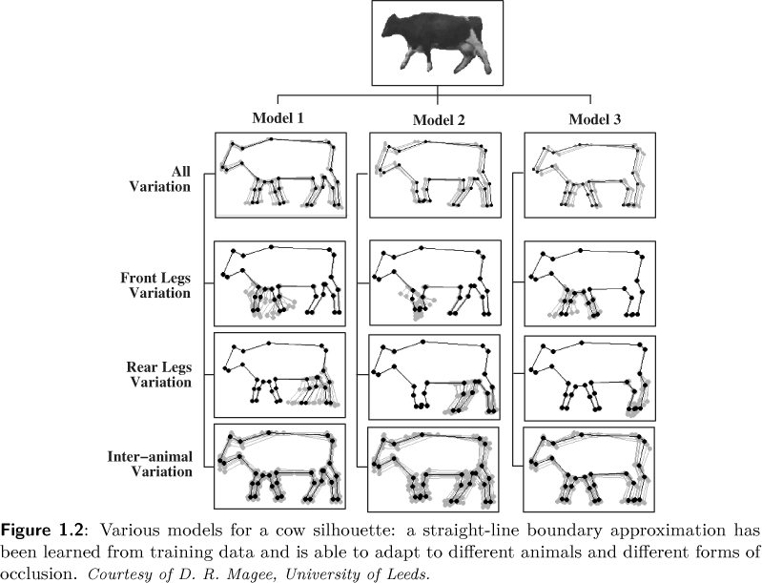
Motivation
Image Processing, Analysis, and Machine Vision, 4th Edition Sonka, Hlavac & Boyle
Training
Creating model

Slide 4
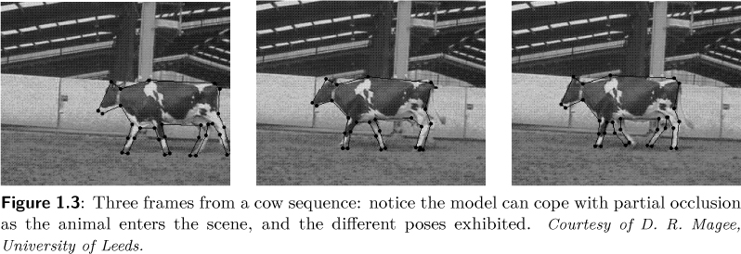
Motivation
Image Processing, Analysis, and Machine Vision, 4th Edition Sonka, Hlavac & Boyle
Detection (testing)

Slide 5
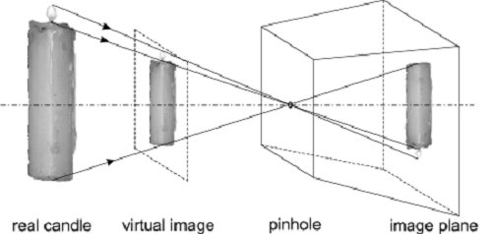
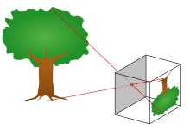
Why is computer vision difficult?
Image Processing, Analysis, and Machine Vision, 4th Edition Sonka, Hlavac & Boyle
Loss of information in 3D to 2D
The pinhole camera model (針孔相機模型) of imaging geometry does not distinguish size of objects.
Virtual image (虛擬影像) vs. image plane (影像平面)
https://en.wikipedia.org/wiki/Pinhole_camera_model

Slide 6
Why is computer vision difficult?
Image Processing, Analysis, and Machine Vision, 4th Edition Sonka, Hlavac & Boyle
Interpretation (闡釋)
Interpretation: image data → model
There may be several interpretations of the same image(s).
Noise (雜訊)
Noise is inherently present in each measurement in the real world.
Too much data
Images are big, and videos are correspondingly bigger.
Brightness measured (亮度測量)
Brightness measured in images is given by complicated image formation physics.
The brightness depends on the light source type(光源類型), intensity and position(光源強度和位置 ), the observer’s position(觀察者的位置), the surface local geometry(物體表面局部幾何形狀), and the surface reflectance properties(物體表面反射特性).
The inverse tasks are ill-posed (不適定問題).

Slide 7
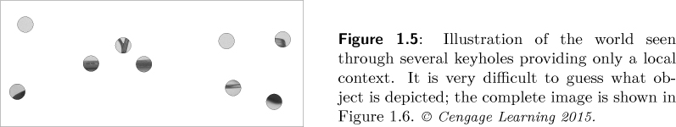
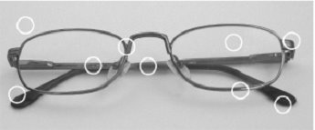
Why is computer vision difficult?
Image Processing, Analysis, and Machine Vision, 4th Edition Sonka, Hlavac & Boyle
Local window v.s. need for global view
Commonly, image analysis algorithms analyze a particular storage bin in an operational memory and its local neighborhood.
The computer sees the image through a keyhole.
This makes it very difficult to understand more global context.

Slide 8
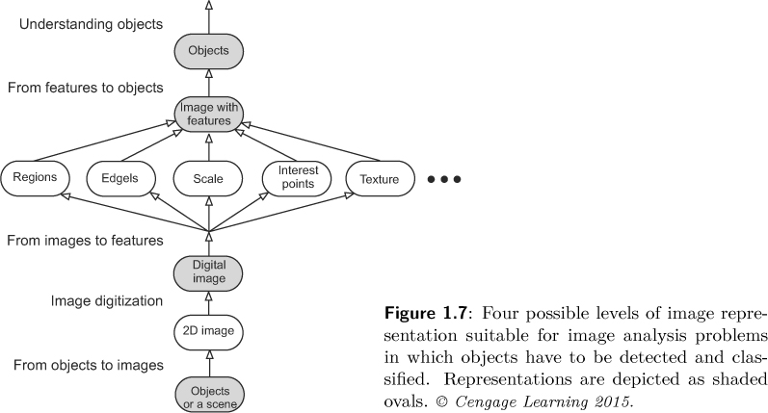
Image representation and image analysis task
Image Processing, Analysis, and Machine Vision, 4th Edition Sonka, Hlavac & Boyle

Slide 9

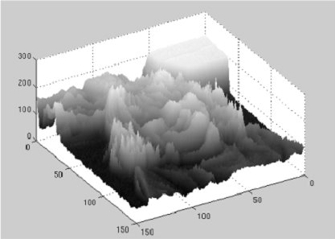


Image representation and image analysis task
Image Processing, Analysis, and Machine Vision, 4th Edition Sonka, Hlavac & Boyle
Both representations contain exactly the same information.
Human observer v.s. machine recognizer

Slide 10
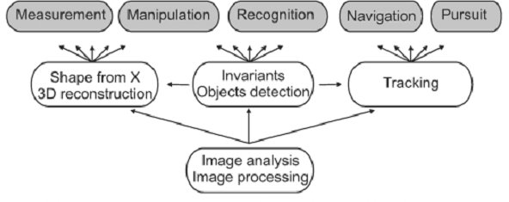
Image representation and image analysis task
Image Processing, Analysis, and Machine Vision, 4th Edition Sonka, Hlavac & Boyle
(量測) (操作) (辨識) (導航) (追蹤)
Several 3D computer vision tasks from the user’s point of view are on the upper line.
Algorithm components on different hierarchical levels support it in a bottom-up fashion.

Slide 11
Homework 1 : image read/write and rotation 作業一： 影像的讀寫與旋轉

